Slide 1
Creational Patterns

Slide 2
Creational design patterns abstract the instantiation process
They help make a system independent of how its objects are created, composed, and represented
This pattern can be further divided into class-creation patterns and object-creational patterns
While class-creation patterns use inheritance effectively in the instantiation process
Object-creation patterns use delegation effectively to get the job done

Slide 3
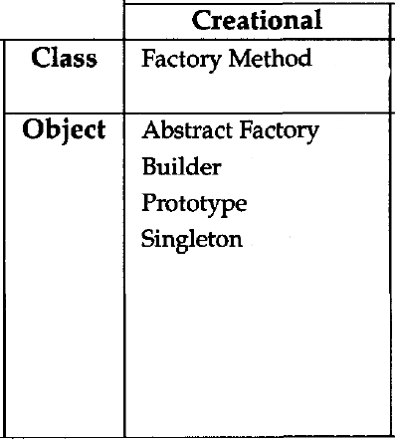

Slide 4

Abstract Factory
Object Creational

Slide 5
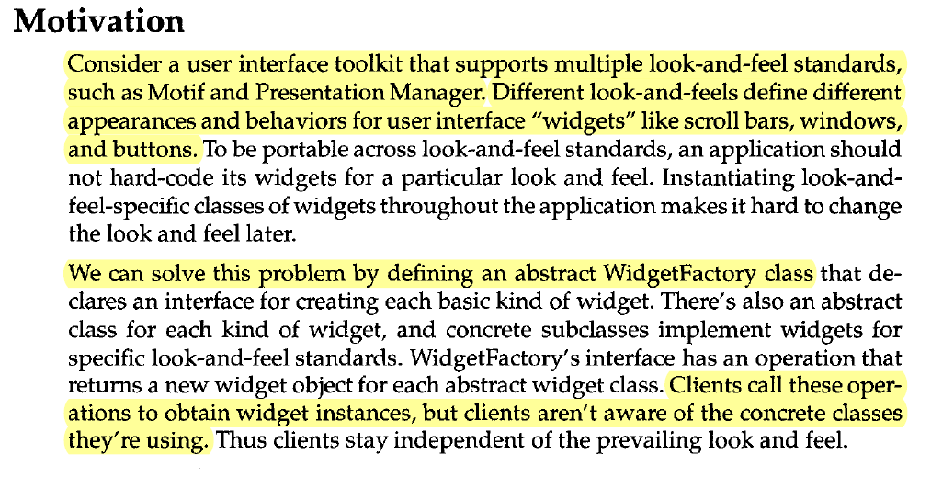

Slide 6
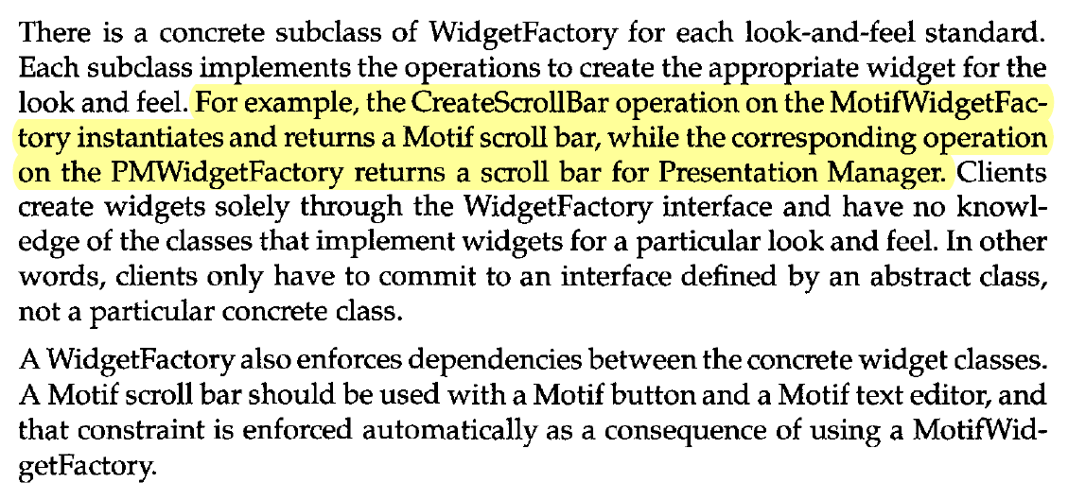

Slide 7
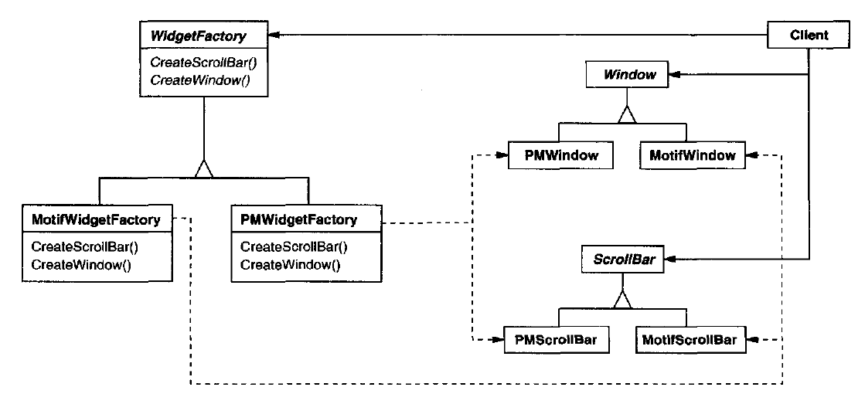

Slide 8
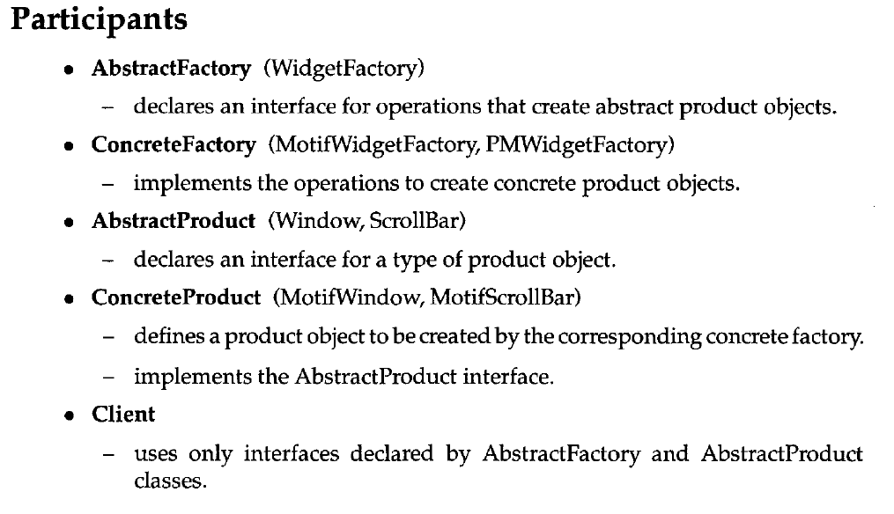

Slide 9
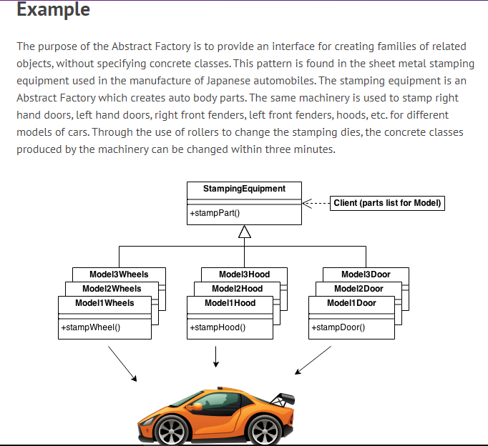

Slide 10

Builder
Object Creational

Slide 11
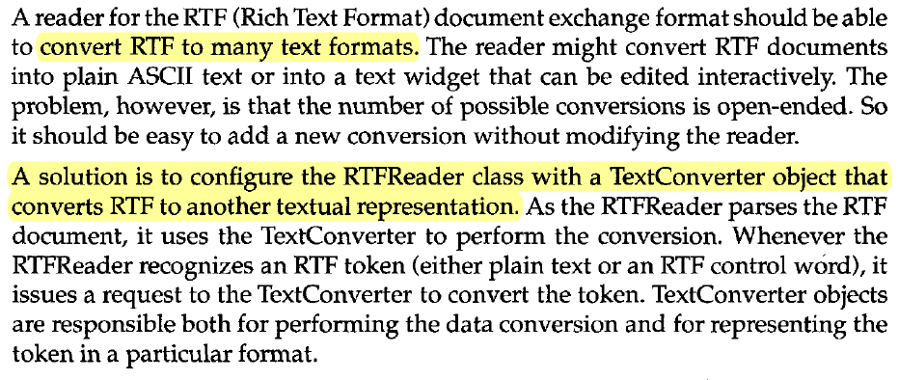

Slide 12
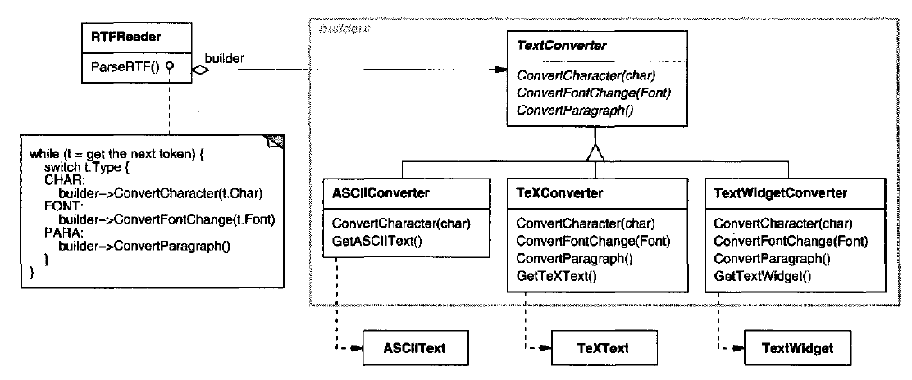

Slide 13

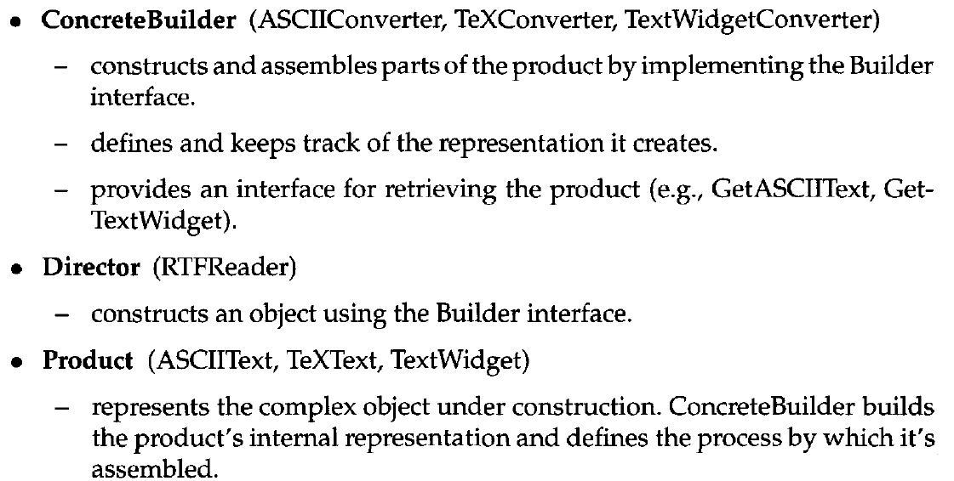

Slide 14
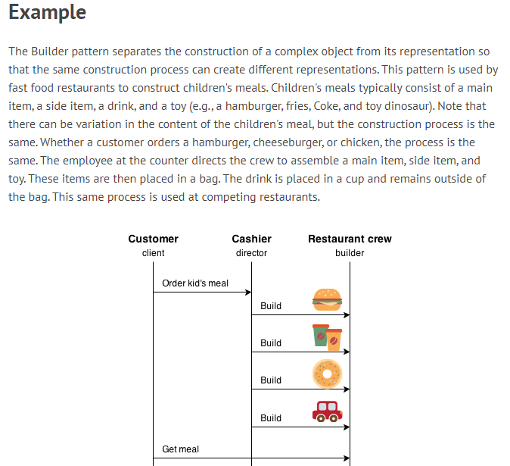

Slide 15

Factory Method
Class Creational

Slide 16


Slide 17
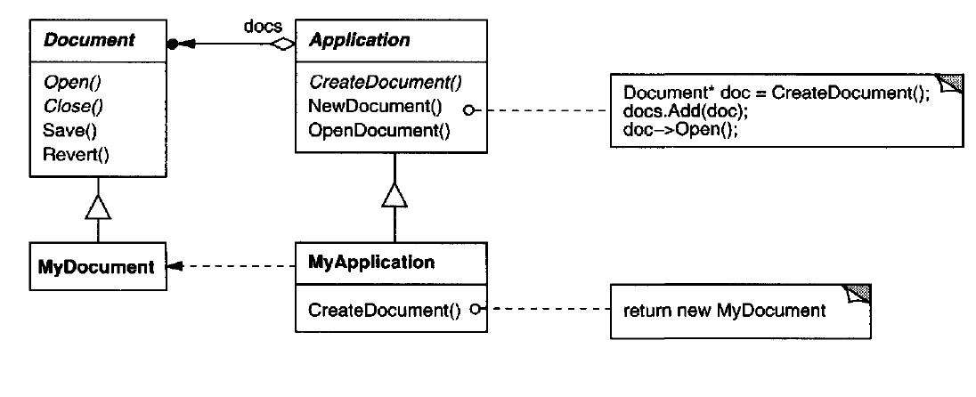

Slide 18
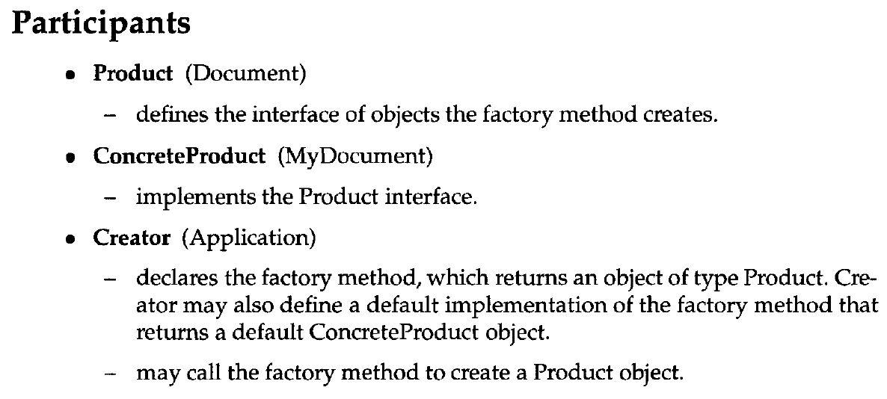


Slide 19
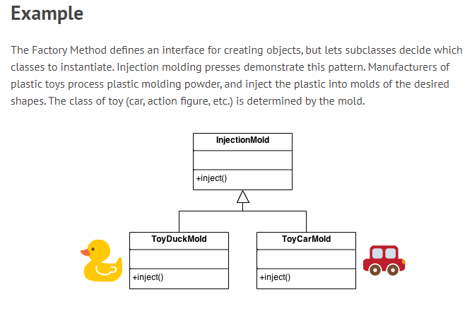

Slide 20

Prototype
Object Creational

Slide 21



Slide 22
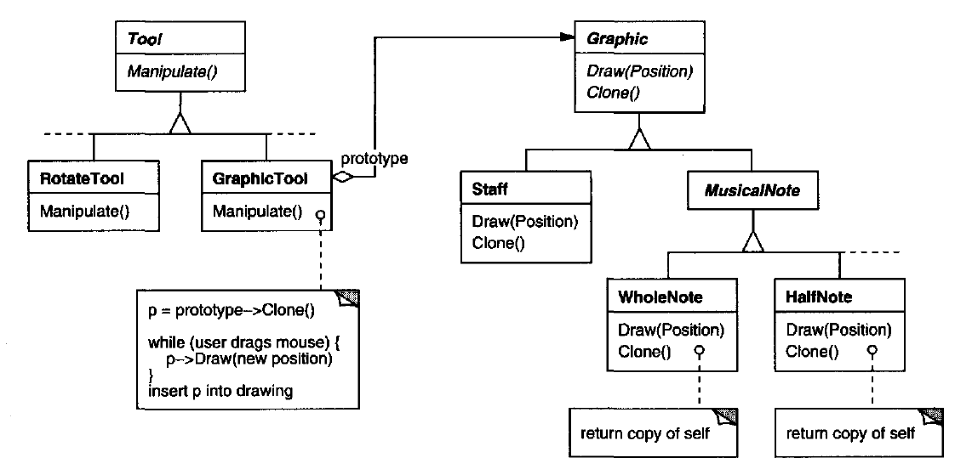

Slide 23
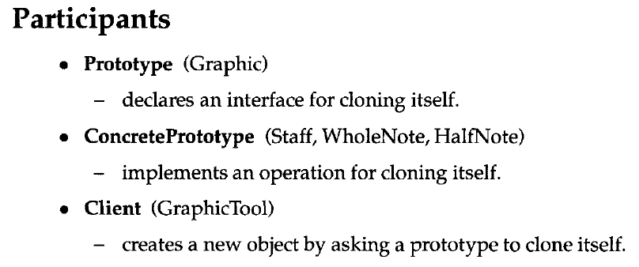

Slide 24


Singleton
Object Creational

Slide 25
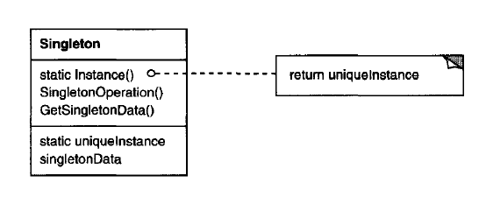


Slide 26
